Slide 1
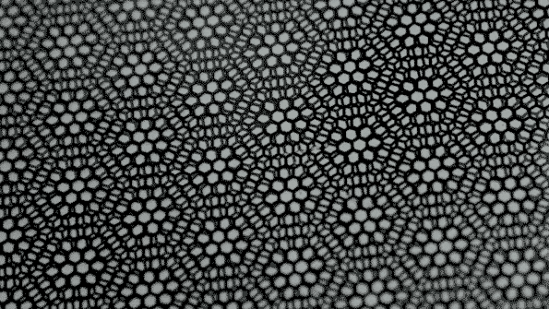
Moiré de graphene

Slide 2
