Slide 1

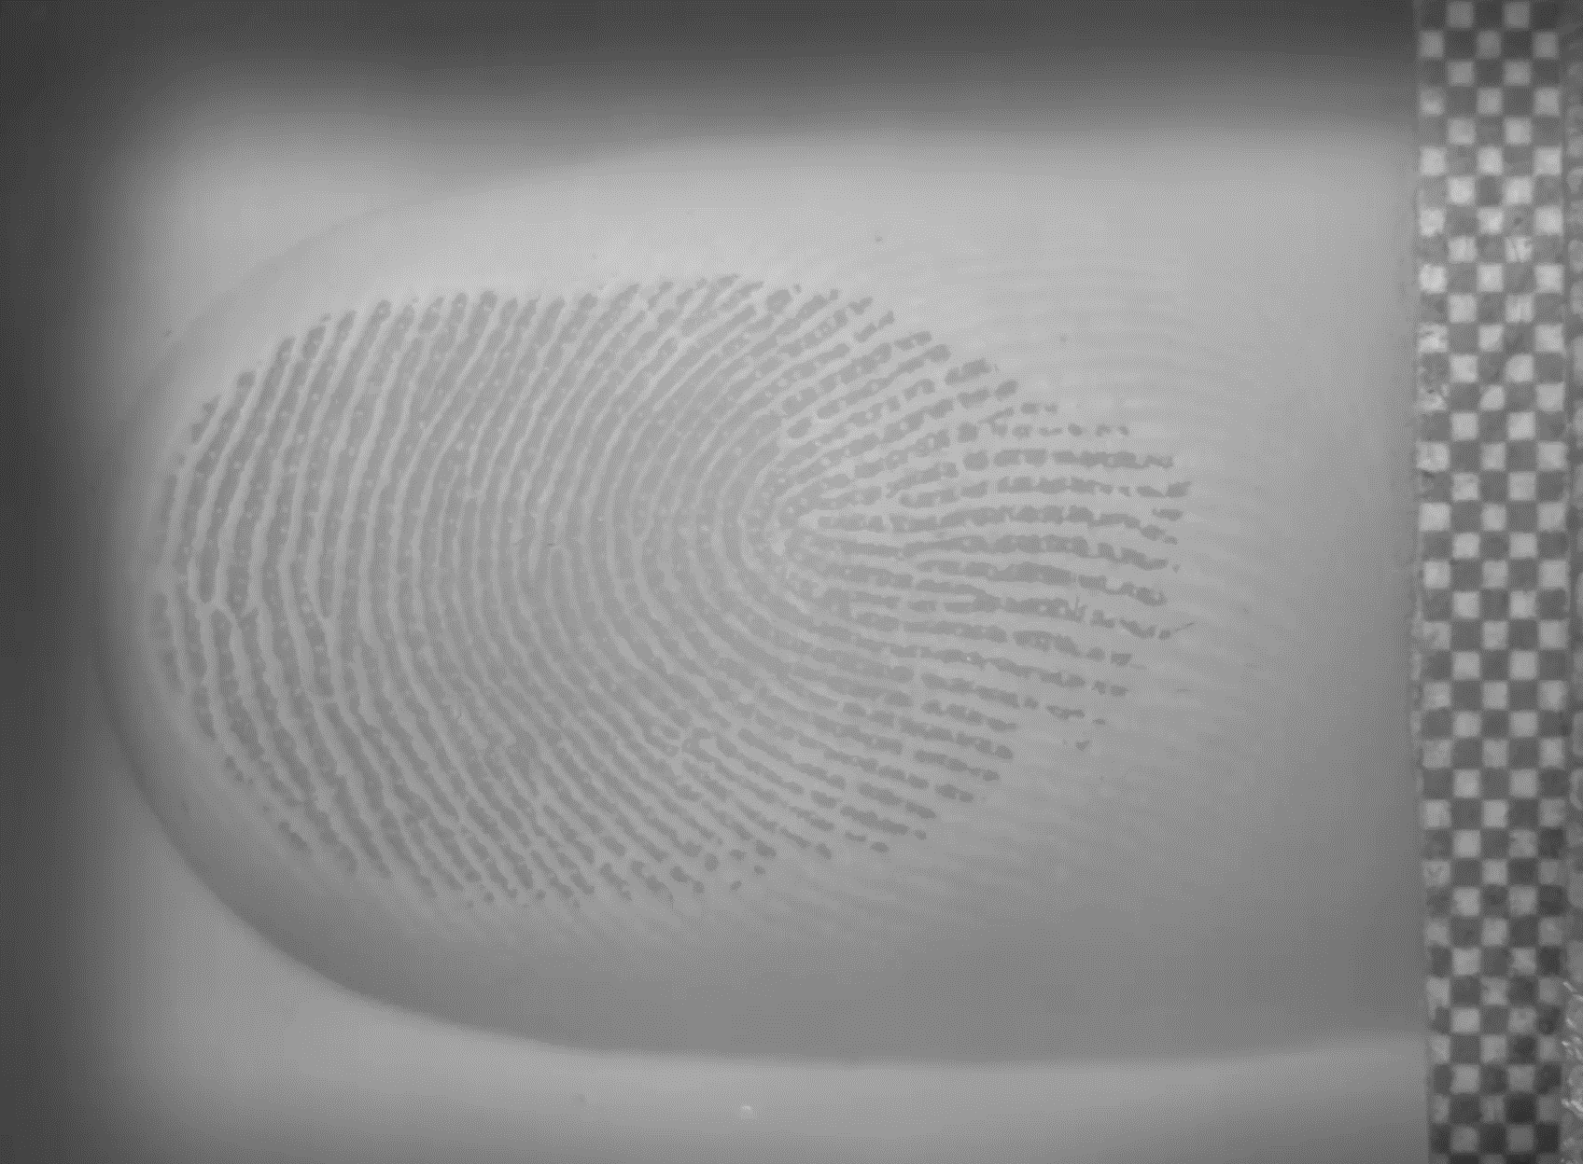
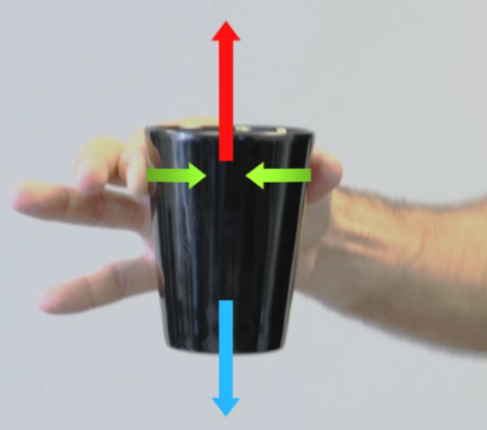
Delhaye, Schiltz, Crevecoeur, Thonnard & Lefèvre, Science Advances 10, eadh9344 (2024)
Fast grip force adaptation to friction relies on localized fingerpad strains
Abstract: During object manipulation, humans adjust the grip force to friction, such that slippery objects are squeezed
more firmly than sticky ones. This essential mechanism to keep a stable grasp relies on feedback from tactile afferents
innervating the fingertips, that are sensitive to local skin strains. This paper demonstrates that this feedback originates from
skin-object interface and strain patterns before lift-off of objects. This allows the nervous system to quickly adjust the contact forces to the frictional properties of manipulated objects. [Publication associated to the GRIP project supported by Belspo]

