Slide 1
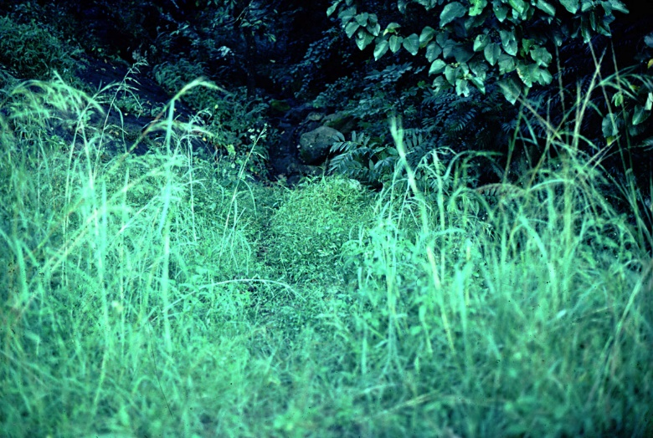
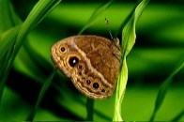
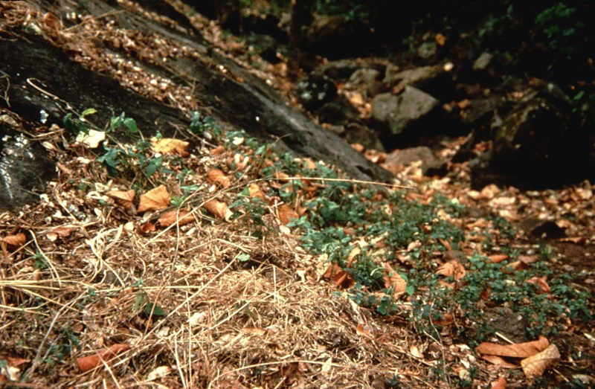
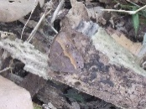
The wet (left) and dry (right) season habitat in Malawi, Africa, with the respective seasonal male butterfly morphs. The wet season is humid and lush with abundant resources and butterflies develop conspicuous eyespots to mislead predators. During the dry season, vegetation cover is reduced and the environment generally harsh and stressful. Butterflies develop into dull and brownish forms aiding their camouflage (credits: William Piel).

